Slide 1

Phased study report on the climate-adaptive food system of Saibai Island
Group Name: KFC
Getao Liu (14560066)
Kaiyang Sun (14547677)
Nelson Clyde(14573861)
Shen Hu (25425075)
Yaofeng Yu (25213935)
Yuxuan Cheng(14556979)
Figure 1

Slide 2
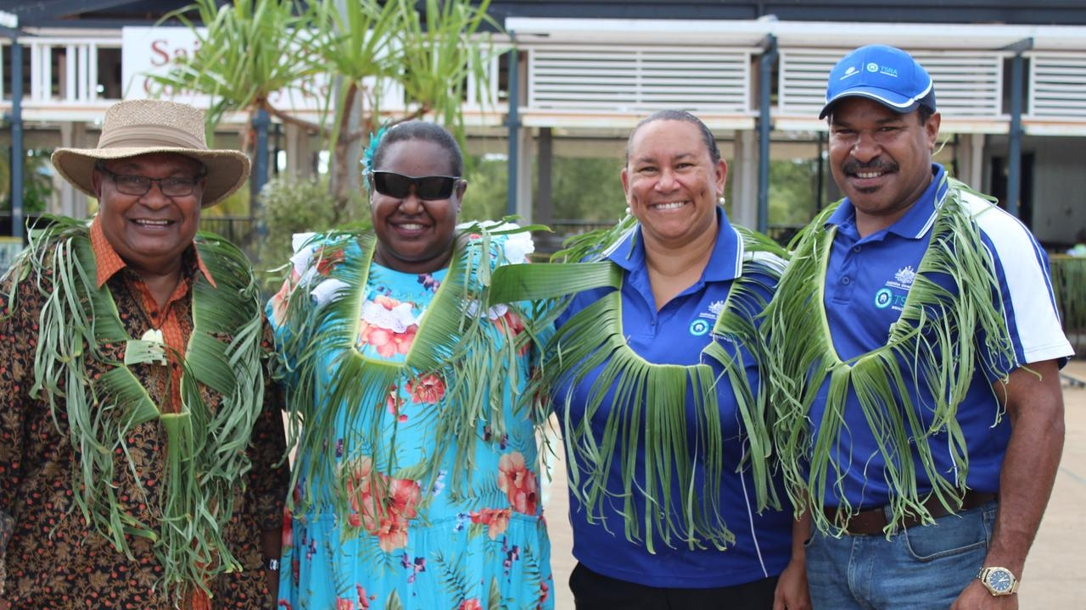
Acknowledgement
Figure 2
Yuxuan Cheng
14556979

Slide 3
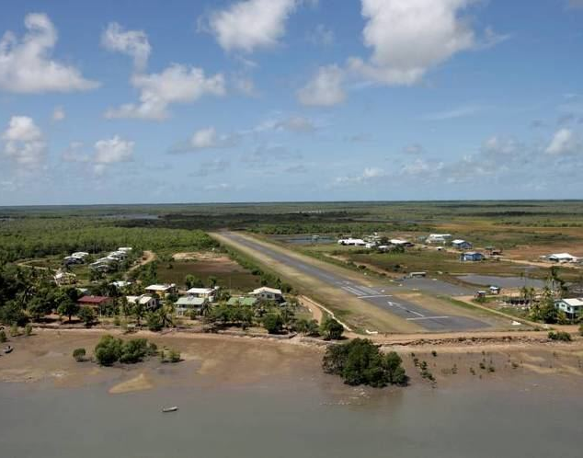
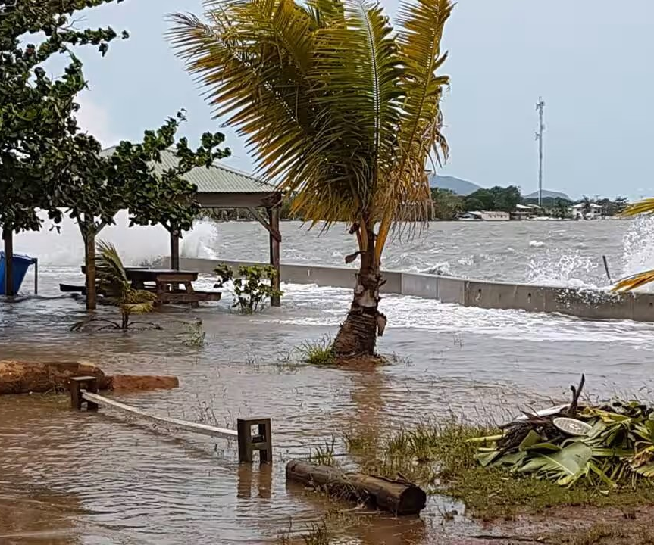
Design Background
Low-lying
floods and tides
Rainfall uneven
floods and drought risks
- Dependent food support
food security problems
Figure 3
Yuxuan Cheng
14556979
Figure 4

Slide 4
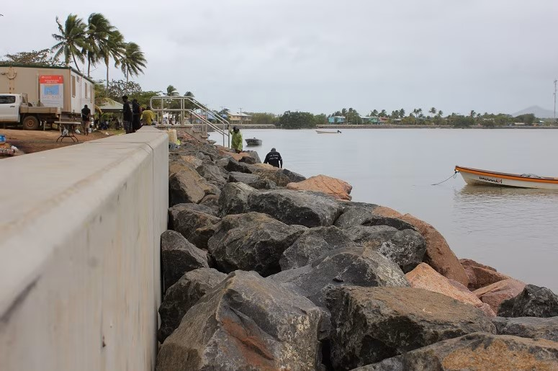
Design question
"How can we help the residents build a more resilient and sustainable food system to adapt to the uncertainties of climate change?"
Figure 5
-Provide food
-Reduce reliance on food import
-Adapt climate change
Yuxuan Cheng
14556979

Slide 5


Challenge and opportunity
Challenge:
Food system
Efficient
Sustainable
Suitable
Opportunity:
Aquaponics system
Fish(provide nutrients)
Plant(filter water)
Yuxuan Cheng
14556979

Slide 6
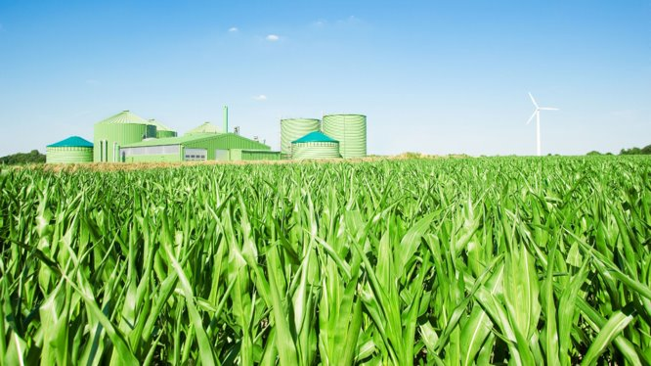
Possible solution: Build sustainable aquaponics systems
Figure 6
Shen Hu
25425075

Slide 7
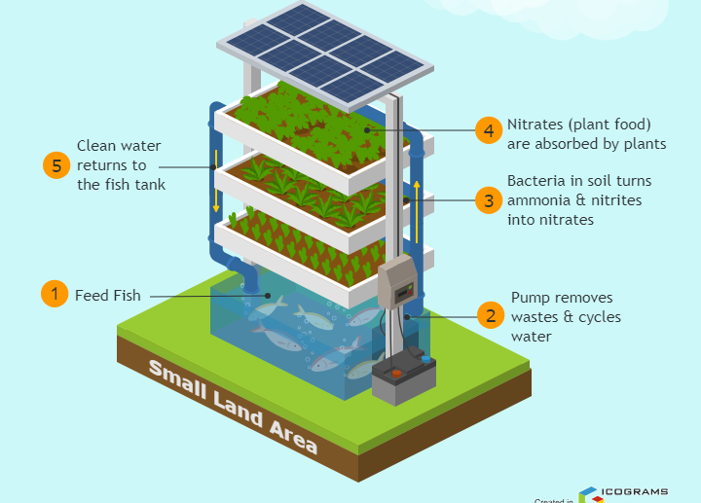
Theory
Land Agriculture
Elevated farmland
Water Agriculture
Fish and plants
Circulation
Water reusing
Green Energy
Solar power
Figure 7
Shen Hu
25425075

Slide 8
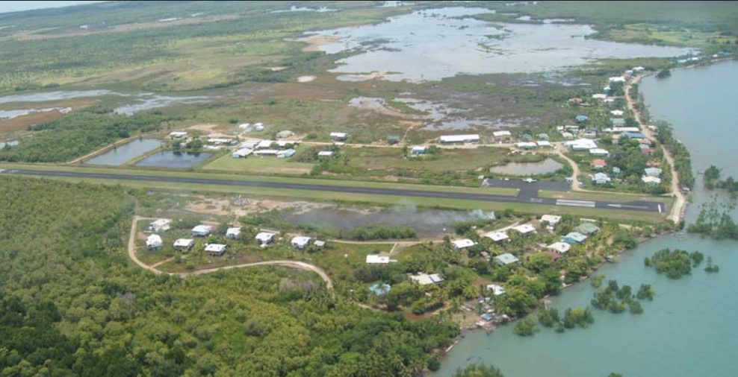
Area
Safety
Far from tides
Enough Land
Planting enough food
Enough Water
Support water agriculture
Short Distance
Apporach to community
Figure 8
Shen Hu
25425075

Slide 9

The Reason for Choosing Our Solution
Provides local food security
Crops & fish are salt- and flood-tolerant
Uses solar energy, reduces diesel costs
Reduces reliance on expensive imports
Figure 9

Slide 10
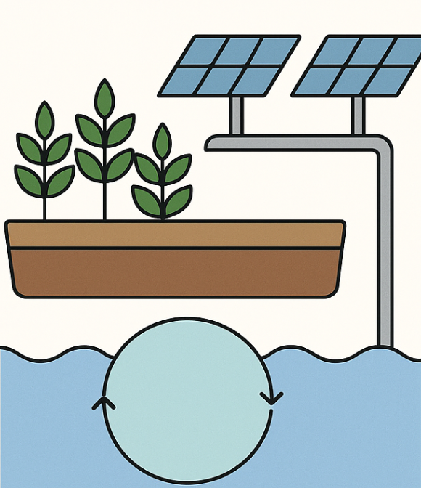
How Our Design Solves the Challenges
Raised farmland + drainage → flood resistance
Water storage + recirculation → dry season supply
Solar-powered pumps → clean & sustainable energy
Local crops & Barramundi → community resilience
Figure 10

Slide 11
Stable Production and Affordability
Aquaponics Closed-Loop System
Split planting and staggered planting
Create a weekly collection pace
Verification: Set goals and compare harvest records
Yaofeng Yu
25213935

Slide 12
Resource Efficiency
Water: Using rainwater first; controlled water bodies
Electric: Time-Scheduled Operation and Low-Head Pumps
Verification: Counting Water Balance Statement; Collecting Weekly Electricity Usage Records
Yaofeng Yu
25213935

Slide 13
Resilience and Simplified Operations
Continuous operation under extreme conditions
Post-ultimate weather recovery
Daily operations (at least 7 hours per week)
Scenario Testing and Acceptance Criteria
Yaofeng Yu
25213935

Slide 14
Prototype
Farmland
Crop & Fish
Power
Water

Slide 15
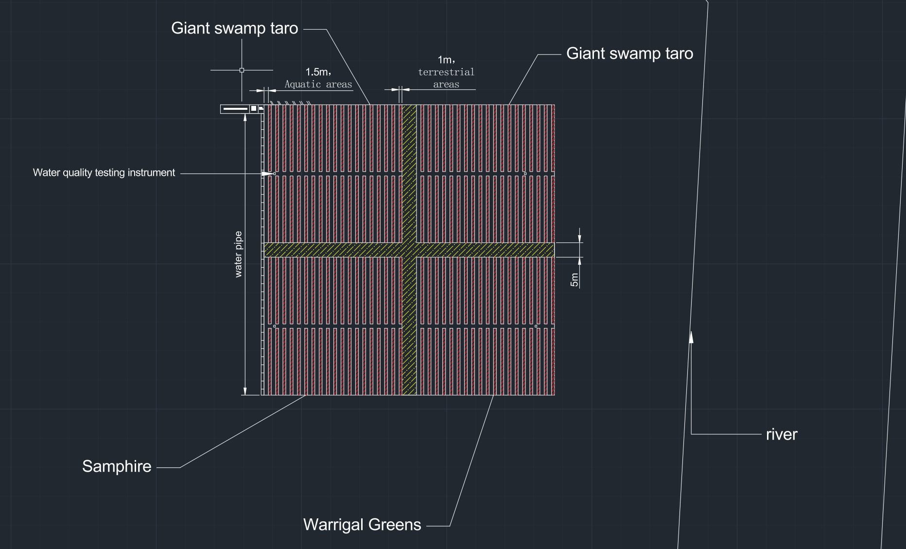
100*100 m
Divided into four sections by the path

Slide 16


farmland
Plant three kinds of plants on each of the four plots of land.
A small piece of land is separated by water.

Slide 17
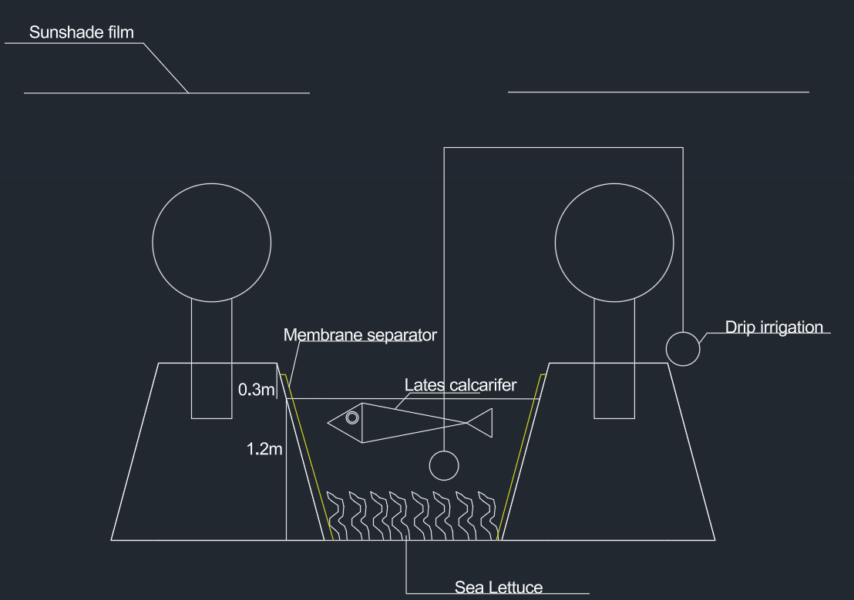
Crop&fish
Only the Giant swamp taro requires shading.
Membrance separator:Stabilize the soil and ensure good air circulation
Drip irrigation:Save water and provide nutrients for the plants
Lates calcarifer:10 to 15 fish/m3
Sea Lettuce:Appropriate planting density

Slide 18
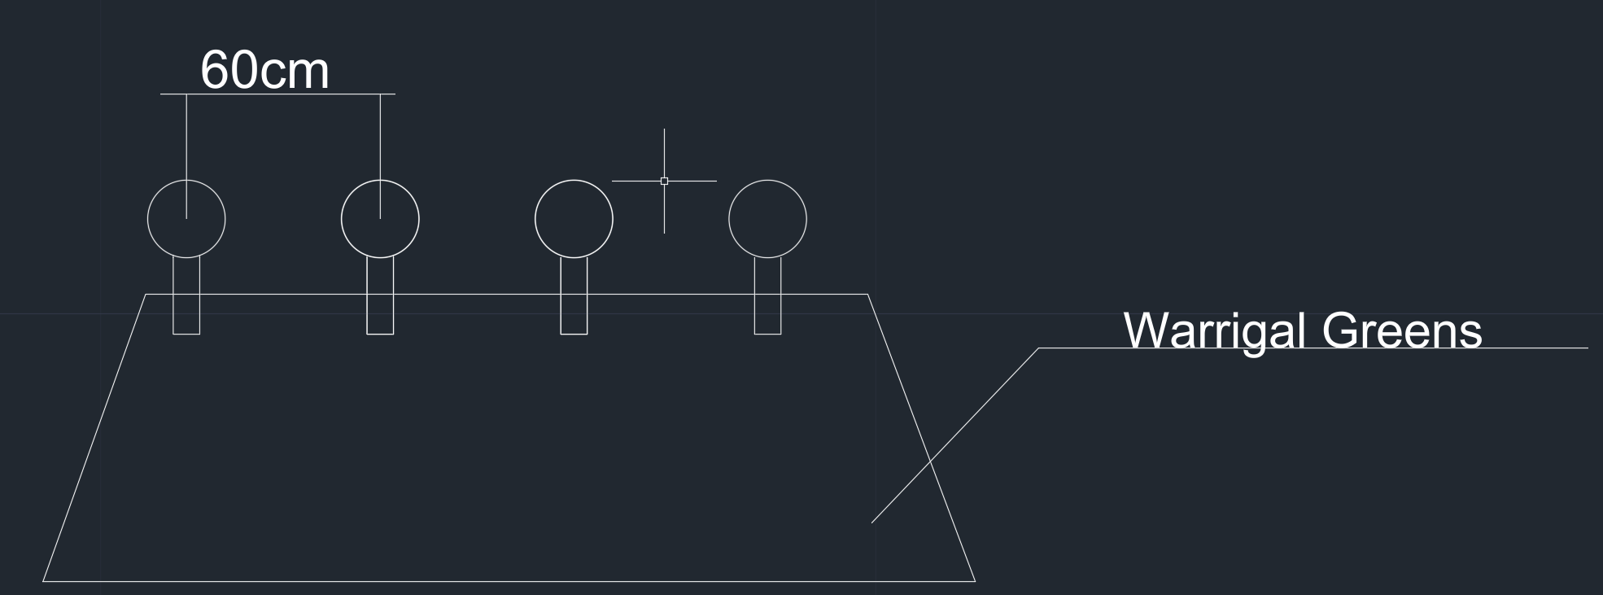
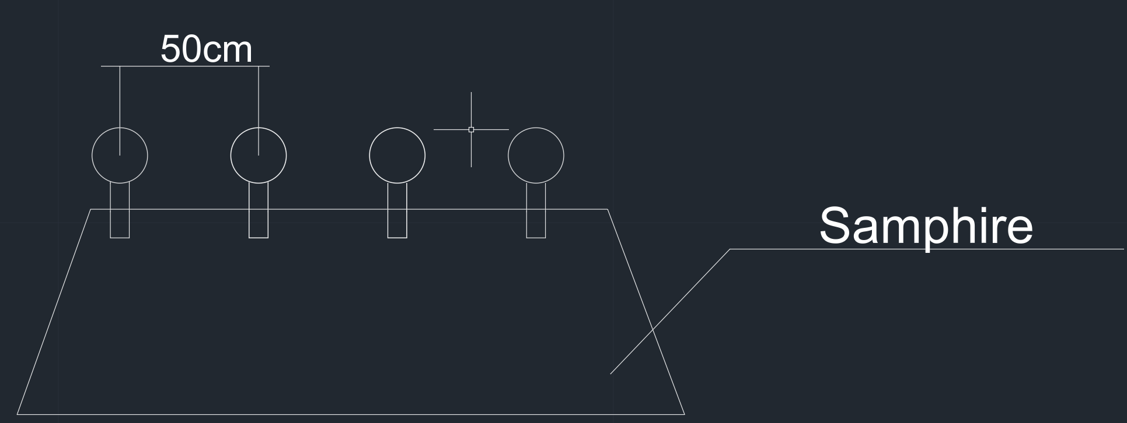

Planting

Slide 19
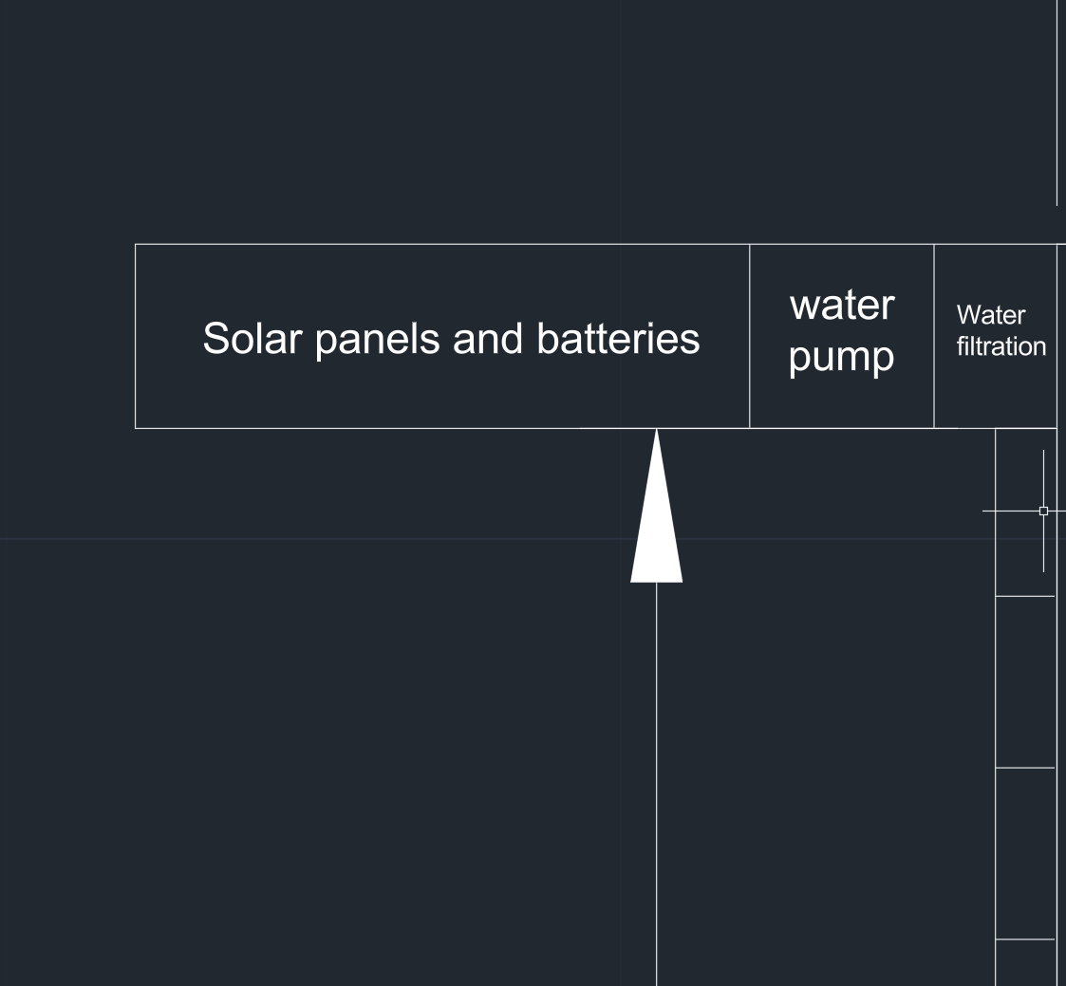
Power
10 solar panels of 1000 watts each (length 2.4 meters, width 1.3 meters), 10 pieces
20-kilowatt battery provides power supply guarantee
Solar energy as the main source, with batteries ensuring stable power supply.

Slide 20
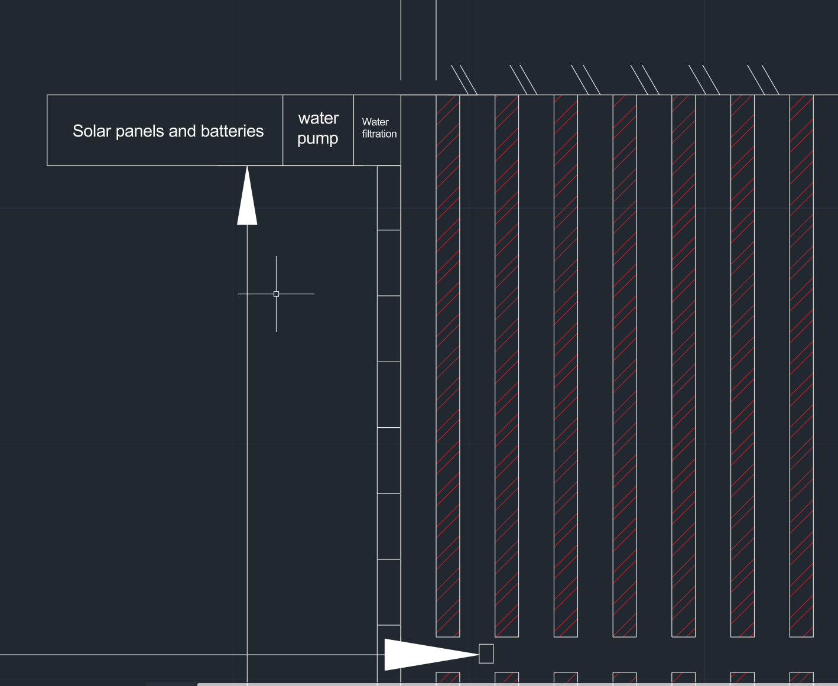
Water
Use plastic pipes to prevent corrosion. The water pump has a power of 10 kilowatts. We expect the system to be fully charged within 24 hours.
Use water quality detection instruments to monitor the condition of the water body.

Slide 21
Implementation – Build & Handover
Steps | Duration
1. Community Co-Design & Approvals | 2–4 weeks
2. Site Preparation & Earthworks | 2–3 weeks
3. Liner & Structural Works | 1 week
4. Plumbing, Pumps & Filtration | 1–2 weeks
5. Water Conditioning & Testing | 2–4 weeks
6. Planting & Fish Stocking | Ongoing (after conditioning)
7. Training & Handover | Continuous (post-build)

Slide 22
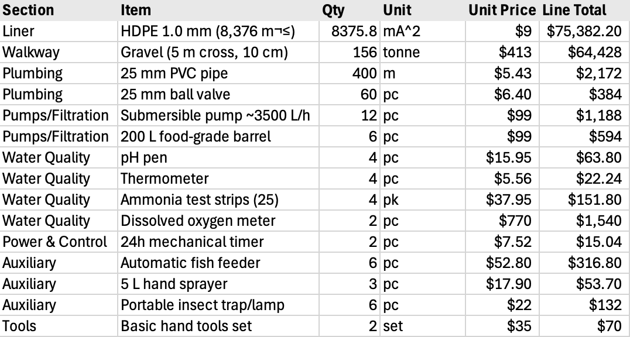
Cost $
Remote Freight & Logistics – $29,302.72
Contingency (10%) - $7,581.63
TOTAL ESTIMATE:
$193,397.93

Slide 23
Useability Test
Energy
Water
Biology
Compliance
Community & Knowledge

Slide 24
Possible issues
Issue | Mitigation Stratergy
Biosecurity / Disease Among Fish | Stage stocking; quarantine new fish; frequent pH and ammonia testing.
Flooding/ Saltwater Intrusion | Raised berms, overflow drains, and careful site elevation planning.
Power Reliability | Hybrid solar-battery backup for pumps; manual aeration contingency.
Freight Delays + Spare Parts | Bulk ordering; store critical spares locally; train community for basic repairs.
Maintenance Skill Gap | Run EWB-led and TSIRC workshops; create SOPs and rosters for operators.
Cultural Fit | Co-design process; respect traditional harvesting times; employ local caretakers.

Slide 25
Conclusion
Nelson Clyde​

Slide 26

Thank You For Your Time

Slide 27
References
Australian Bureau of Statistics. (2025). Agricultural production in Torres Strait region. Australian Bureau of Statistics. https://www.abc.net.au/news/saibai-islanders-risking-lives-illegal-png-fishers
Australian Energy Regulator. (2025). Ergon Energy ring-fencing waiver: Isolated networks. https://www.aer.gov.au/industry/networks/ring-fencing/ergon-energy-ring-fencing-waiver-isolated-networks-2025
Australian Institute of Aboriginal and Torres Strait Islander Studies. (2016). Saibai Mekem gardening project: Developing long term sustainability and wellbeing of Saibai community. https://aiatsis.gov.au/publication/116805
Bureau of Meteorology. (2025). Climate statistics: Horn Island (Site 027058). https://www.bom.gov.au/climate/averages/tables/cw_027058.shtml
CHOICE. (2024, October 31). Groceries cost more than twice as much in some remote First Nations communities. https://www.choice.com.au/about-us/media/media-releases/2024/october/groceries-cost-more-than-twice-as-much-in-some-remote-first-nations-communities
Department of Agriculture, Fisheries and Forestry. (2023). Shipping and yachting in Torres Strait. https://www.agriculture.gov.au/biosecurity-trade/policy/australia/naqs/torres-strait
Department of Agriculture, Fisheries and Forestry. (2025a). Climate adaptation and food security in Northern Australia. Australian Government. https://www.agriculture.gov.au/biosecurity-trade/policy/australia/naqs/moving-goods-torres-strait

Slide 28
Department of Agriculture, Fisheries and Forestry. (2025b). Moving goods from, within and to Torres Strait. https://www.agriculture.gov.au/biosecurity-trade/policy/australia/naqs/moving-goods-torres-strait
eAtlas. (2016, February 17). Saibai: Land and sea profile. Australian Institute of Marine Science. https://eatlas.org.au/sites/default/files/2024-12/Saibai%20Land%20and%20Sea%20Profile%2017-02-16.pdf
EcoWatch. (2022, September 23). Australia failed to protect Torres Strait Islanders from climate change, violating their rights, UN says. https://www.ecowatch.com/australia-climate-change-un-human-rights.html
Engineers Without Borders Australia. (2024, June 17). Navigating the tides: Saibai Island’s battle against climate change. https://ewb.org.au/blog/2024/06/17/navigating-the-tides-saibai-islands-battle-against-climate-change/
Engineers Without Borders Australia. (2025a). Design Area 5 – Climate change adaptation. https://ewbchallenge.org/challenge/saibai-island-tsirc/design-area-5-climate-change-adaptation/
Engineers Without Borders Australia. (2025b). EWB Challenge 2025: Climate change adaptation in the Torres Strait. https://ewbchallenge.org/challenge/saibai-island-tsirc/
Engineers Without Borders Australia. (2025c). Introduction to Saibai Island. https://ewbchallenge.org/challenge/saibai-island-tsirc/introduction-to-saibai-island/

Slide 29
Engineers Without Borders Australia. (2025d). Saibai Island, TSIRC. https://ewbchallenge.org/challenge/saibai-island-tsirc/
Ergon Energy. (n.d.). Isolated & remote power stations. https://www.ergon.com.au/network/our-network/isolated-and-remote-power-stations
Green, D., & Warusam, H. (2010). Building resilience to climate change impacts on Saibai, Torres Strait. Reef and Rainforest Research Centre Limited.
House of Representatives Standing Committee on Indigenous Affairs. (2020). Report on food pricing and food security in remote Indigenous communities. https://www.aph.gov.au/Parliamentary_Business/Committees/House/Former_Committees/Indigenous_Affairs/Foodpricing/Report
Huusko, S. (2015, December 8). 'We’re sinking here': Climate change laps at front door of Torres Strait Islands. The Guardian. https://www.theguardian.com/australia-news/2015/dec/08/were-sinking-here-climate-change-laps-at-front-door-of-torres-strait-islands
Icograms Designer. (25 Jan, 2024). Aquaponics System Diagram. Aquaponics System Diagram - Icograms Template
Maritime Safety Queensland. (2025). King tides. https://www.msq.qld.gov.au/tides/king-tides
National Indigenous Australians Agency. (2021, December 2). Australian Government response to the House of Representatives Standing Committee on Indigenous Affairs report: Inquiry into food pricing and food security in remote Indigenous communities. https://admin.niaa.gov.au/sites/default/files/documents/publications/final-govt-response-HORSCIA-report.pdf

Slide 30
Park, A., McDonald, A., & Ky, J. (2021, April 18). For these Torres Strait Islanders, climate change is already here — and they’re urging the government to do more. ABC News. https://www.abc.net.au/news/2021-04-19/torres-strait-islanders-climate-change-impacts-uninhabitable/100069596
Queensland Government. (n.d.). Land and water management policies in the Torres Strait. https://www.qld.gov.au
Queensland Government. (n.d.). Saibai. https://www.qld.gov.au/firstnations/cultural-awareness-heritage-arts/community-histories/community-histories-s-t/community-histories-saibai
Time and Date. (n.d.). Climate & weather averages in Saibai Island, Queensland, Australia. https://www.timeanddate.com/weather/%402101466/climate
Torres Cape Indigenous Council Alliance. (2023). Far North Queensland freight equalisation study. https://tcica.com.au/wp-content/uploads/2023/02/tci1241_freight-equalisation-study-final.pdf
Torres Strait Island Regional Council. (2024a). Saibai Island master plan. https://tsirc.qld.gov.au/wp-content/uploads/2024/12/Saibai-Island-Master-Plan.pdf
Torres Strait Island Regional Council. (2024b). Zenadth Kes coastal hazard adaptation strategy. TSIRC.
Torres Strait Island Regional Council. (2025a). Saibai Island community plan 2025–2030. https://www.tsirc.qld.gov.au

Slide 31
Torres Strait Island Regional Council. (2025b). Water security and infrastructure strategy. https://www.tsirc.qld.gov.au
Torres Strait Regional Authority. (2011). Observed and future climates of the Torres Strait region. https://www.tsra.gov.au/document/observed-and-future-climates-of-the-torres-strait-region-2011/
Torres Strait Regional Authority. (2016). Torres Strait regional adaptation and resilience plan 2016–2021. TSIRC.
Torres Strait Regional Authority. (n.d.). Sustainable human settlements. Torres Strait State of the Environment. https://torresstraitsoe.org.au/land/sustainable-human-settlements/
Wellauer, K., & Ruddick, B. (2024, December 15). Islanders determined to keep hope, culture alive as Torres Strait rises. ABC News. https://www.abc.net.au/news/2024-12-15/rising-ocean-threat-to-island-culture-torres-strait-australia/104613496

